Slide 1
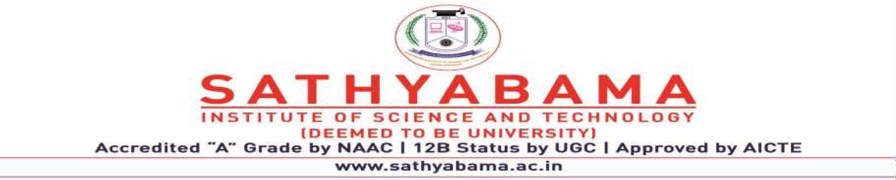
FAST Application using Microsoft Cognitive Services
Project Supervisor: ,Dr. R. Aroul Canessane
Name of the Student: Mr. thaira baee
Register Number: 39110819

Slide 2
Presentation Outline
Course Certificate
Introduction
Objectives
System Architecture / Ideation Map
Module Implementation
Application Snapshots
Results and Discussions
Conclusion & Future work
References
8 November 2021
Department of CSE
2

Slide 3
Course Certificate
Attach your Course Certificate here
8 November 2021
Department of CSE
3

Slide 4
Introduction
Robotic process automation (RPA) is a software technology that makes it easy to build, deploy, and manage software robots that emulate humans actions interacting with digital systems and software. Just like people, software robots can do things like understand what’s on a screen, complete the right keystrokes, navigate systems, identify and extract data, and perform a wide range of defined actions.
To create a bot that automaticallysend emails with attachments to a list of people

Slide 5
Objective:
The main objective behind this is to get familiar with MS EXCEL VBO and emails with attachment to bunch of people

Slide 6
OBJECTIVES:
Gain insights into building blocks of blue prism automation.
Importing MS Excel VBO (Visual Basic for Applications) in Blue Prism.
Importing Email VBO (Visual Basic for Applications) in Blue Prism.
Tuning Process Studio with specific needs.
Working with different stages in the Process studio.
Building a bot to automatically send mails with attachments to a list of people.
Scope of RPA:
RPA has provided an excellent solution for organizations repetitive,mundane,rule –based processes with software bots
It is now helping organizations who were looking to increase their
to replace
workflow accuracy and in the IT sector
To accomplish this:
Configure the process model:
Import MS Excel VBO
Import Email VBO
Process Model binding with MS Excel VBO
Process Model binding with Email VBO
Adding Process Stages: Create Instance Open Excel file Getting email IDs Configuring Email Fetching attachments Sending mails
Test the model
Test Process Model
1.
2.
3.
4.
5.
6.

Slide 7
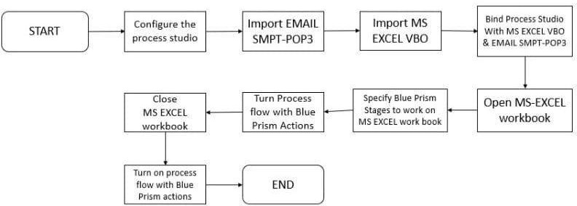
System Architecture / Ideation Map

Slide 8
Project Implementation
Hardware and Software Requirements:
The following is the Hardware required to complete this project:
Internet connection to download and activate
Administration access to install and run Blue Prism
Minimum 10GB free disk space
Windows 8.1 or 10 (64-bit version only) OR Cloud: Get started free, *Cloud account required.
2) Minimum System Requirements To run Office Excel 2013, your computer needs to meet the following minimum hardware requirements:
500 megahertz (MHz)

Slide 9
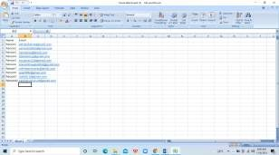
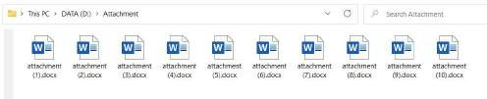
256 megabytes (MB) RAM
1.5 gigabytes (GB) available space
1024x768 or higher resolution monito
Construction or Fabrication:
Activity 1:
Step 1:First store the name and email address of the people in Excel
Store the attachment to add in email in a folder
Step 2: Import EMAIL POP3/SMTP
Click on file->Then on import->then Process/Object->Browse-> (C:\Program Files\Blue Prism Limited\Blue Prism Automate\VBO\BPA Object – Email- POP3_SMTP.xml) ->click Next->Then Finish.

Slide 10
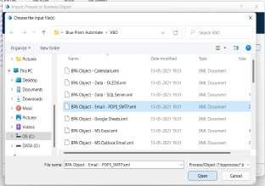
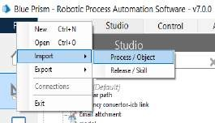
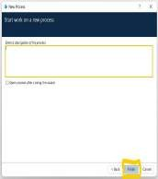
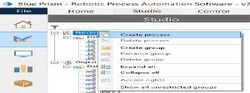
Activity 2:
Step 1: create a process After launching the Blue Prism, Open Studio tab, right-click on process, and select Create process.Give the name as Email attachment then click next and then finish. The screenshots clearly explain the process of creating process.
Step 2:
Create an action stage, select MS Excel VBO from Business object drop down, select Create instance action.
Create Data Item as follows, • type = number, • name =” handle”.

Slide 11
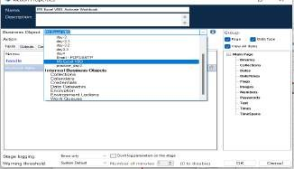
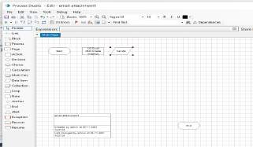
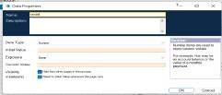
handle”.
Create Data Item as follows, • Data type = number, • name =”
Go to output tab and drag handle into Store In click on ok

Slide 12
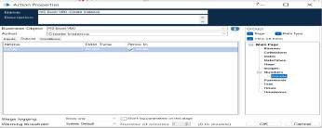
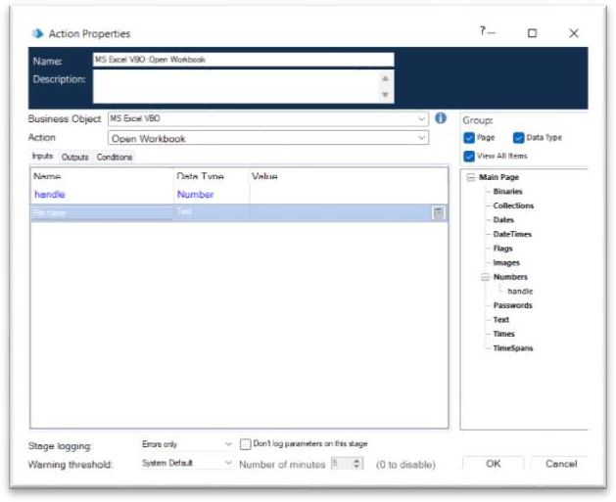

Step 3:
Create an action stage, select MS Excel VBO from Business object drop down, select Open Workbook action
In the input tab give the handle and path of the excel file
name”
Create Data Item as follows, • type = text; name =” Workbook

Slide 13
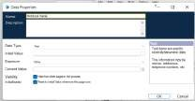
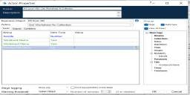


Step 4:Create an action stage, select MS Excel VBO from Business object drop down, select Get worksheet as collection.
.Create Collection,and click on add with fields as follows, • type = text; name =” Name” • type = text; name= “Email”.And Go to output tab and drag Data into Store in column, click on ok.
Step 5:
Create an action stage, select MS Excel VBO from Business object drop down, select Close Instance action.
Drag and drop the handle, click on ok.

Slide 14
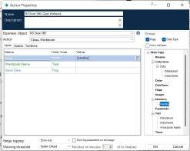
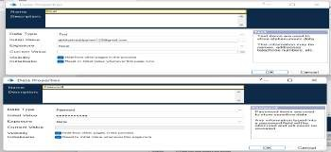
Step 6:Add two data items one for Email and other for Password.
1.To store the Email
Name – Email
Type – Text
Initial value – Your email ID
2. To store the Password
Name - Password
Type – Password
Initial value – Password of your email ID
Step 7:Create an action stage, select Email VBO from

Slide 15
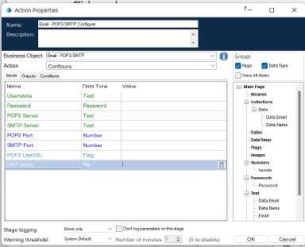
Business object drop down, select Configure action.
In the input tab drag the Email and Password and the give the following details:
POP3 Server = "pop.gmail.com"
SMTP Server = "smtp.gmail.com"
POP3 Port = 995
SMTP Port = 587
POP3 UseSSL = True
SMTP UseSSL = True
Step 8:Add a loop stage and make it to loop
for Data collection.
Drag and drop a loop stage and change the arrangement of all the stages in the page, double click on it and in the collection drop down select data collection and click ok.

Slide 16
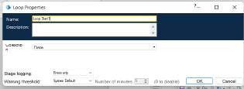
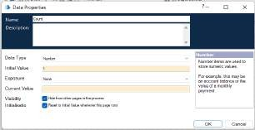
Step 9:Add two data items
Data item 1
To store the number to increment the path for each attachment
Name – Count
Type – Number
Initial value – 1
Second data item
To store the path of the attachment (only the constant path. For the numerical part we will be using calculation stage.
Name – Path
Type – Text
Initial value – constant values in the attachment path

Slide 17
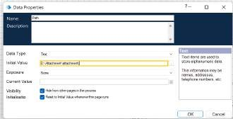
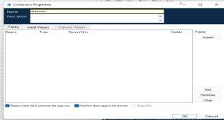
Step 10:drag and drop a collection, rename it as Attachment
give the following as initial fields Name – Path;
type – Text

Slide 18
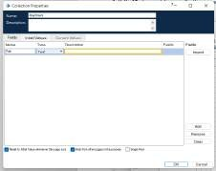
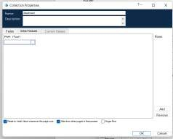
Create a row in initial values column.
Step 11:
Add a multi calculation stage to store the path to Attachment collection and to calculate path. Drag and drop a multi calculation stag

Slide 19
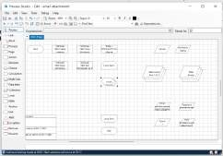
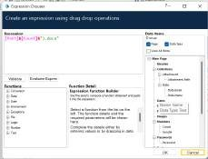
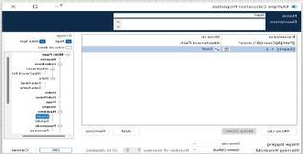
double click on it and add the following:
Calculate the path and store it in Attachment collection.
Increment count.
Step 12:
Create an action stage, select Email SMTP from Business object drop down, select Send message action.

Slide 20
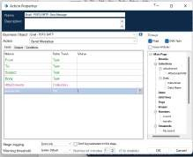
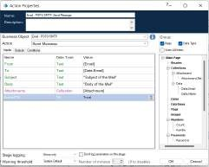
In the input tab give the following details:
From = Email data item
To = Email from data collection
Subject = The subject you want to send
Body = The body you want to send
Attachment = Attachment collection Click on ok

Slide 21
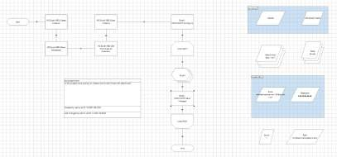
Step 13:Link all the stages and run the bot at different timings to notice getting login to different classes. Do Proper connections (Links).
Measurement and Analysis:
1)cost effective 2)accuracy&quality 3)consistency 4)improved analytics
5)increased employee productivity

Slide 22
Interpretation of Results:
Email automation is a powerful marketing automation tool that lets you send the right message to the right people at the right time.
Can produce the accurate results without any deviation in terms of quality it gives the perfect output.

Slide 23
Methodology
Agile

Slide 24
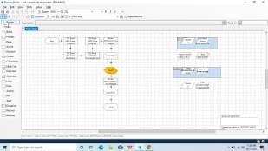
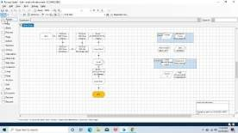
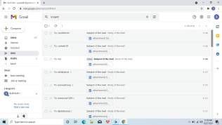
Results and Discussion
This picture shows result

Slide 25
Conclusion
Conclusion:
On doing this project we got to know that email automation is very important for our further Development . At first we have to store the each person email id in Microsoft Excel and save it for later use.Then we have to import MS-EXCEL VBO and Email SMTP-POP3 VOB into the Blue Prism , then create
the process and then we have to give the following actions such as create instance , opening excel file , getting email id's , closing the excel file , Configuring Email,fetching the attachments and then sending the mails. Click on refresh button then click run button to run the program.Then the resultant output will be emails sent with the attachment.
With a a few chats of our group members the overall planning and research regarding our
project went well.We all tried our best and included the necessary points required regarding our topic.
Future scope:
In future many developments will take place in this email automation.This tecnique will become a lot more useful to develop the email marketing. Almost 80-90% population use this top jen tool

Slide 26
References
M. Lacity, L. P. Willcocks, & A.Craig.Robotic process automation at Telefonica O2.The Outsourcing Unit Working Research Paper Series, 2015
IRPA, “Introduction To Robotic Process Automation,” tech. rep., 2015.
H. P. Fung "Criteria, use cases and effects of information technology process automation (ITPA)." Advances in Robotics & Automation 3 (2014).
Dana Nau, Malik Ghallab, and Paolo Traverso Automated Planning: Theory & Practice. Morgan Kaufmann, 2014.
M. Barrett, E. Oborn, W. J. Orlikowski, and J. Yates, “Reconfiguring 4Relations: Robotic Innovations in Pharmacy Work ,” Organ. Sci., vol. 23, pp. 1448– 1466, 2012.

